Slide 1



Electric Vehicle Charging Analysis

Slide 2

Learning Objectives
• Understand EV charging patterns • Analyze charging session data to find usage trends • Apply Python for data cleaning and processing • Visualize charge-wise distribution using charts • Learn data driven insights for EV infrastructure planning
✅ Goal
The goal of this project is to analyze EV vehicle charge-wise data and understand how users behave while charging their vehicles.
GOAL
Source :
www.freepik.com/

Slide 3
Tools and Technology used
• Python • Pandas • Matplotlib / Seaborn • Jupyter • CSV dataset (EV charge wise data)

Slide 4
Methodology
Dataset loading
Data cleaning
Feature processing
Charge level categorization
Visualization of charge usage
Insight generation

Slide 5
Problem Statement:
With the increase in EV adoption, it is important to understand how vehicles are being charged. The challenge is to analyze charging patterns and identify how often users charge at different levels.

Slide 6
Solution:
Used Python to load and preprocess EV charging data • Segmented the charging records into specific charge-wise categories • Visualized the distribution to identify which charge levels are most commonly used • Generated insights to help optimize charging infrastructure

Slide 7
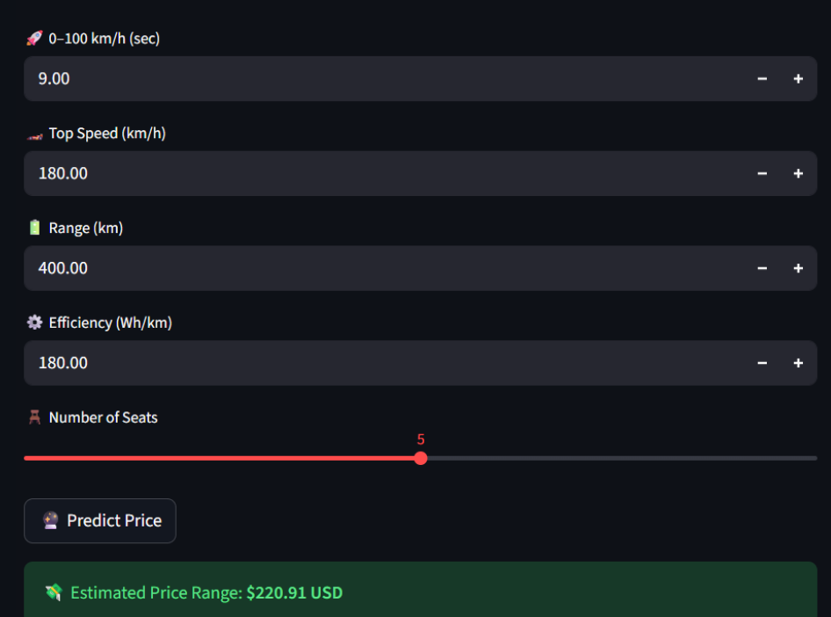
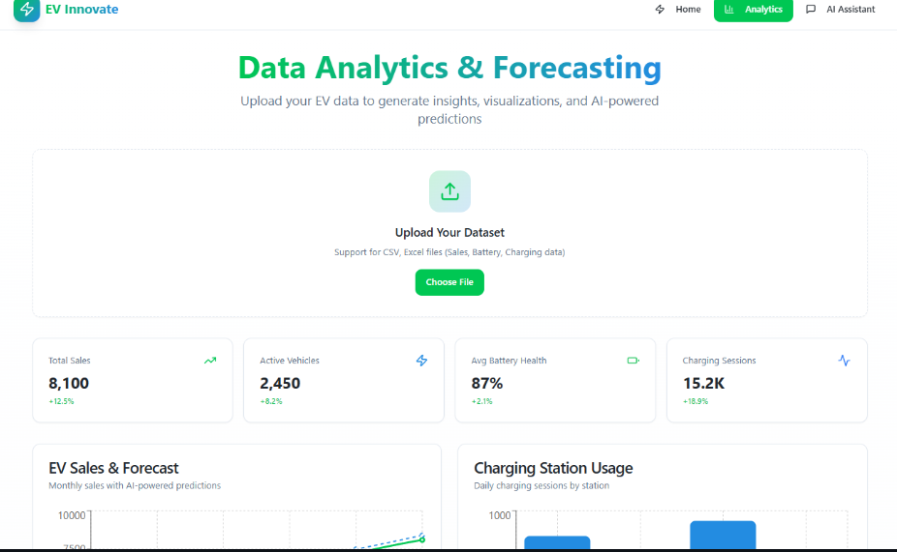

Screenshot of Output:

Slide 8
Conclusion:
This project successfully analyzes electric vehicle charging behavior using Python. The insights help understand which charge levels are most preferred and support data-driven planning for EV charging stations.

